Slide 1
Milestone 3 - Point to Point Pathfinder
t(n) = c(n) + f(n)
total cost
current cost from Start
future predict cost to End
Modified version of A*
Every Point
Smallest total theoretical cost t(n)
The previous point on the path which computes the smallest t(n)
A
End
t(A) = c(A) + f(A)
Start
f(A)
c(B)
f(B)
Start
A
c(A)
B
B
t(B) = c(B) + f(B)
A
Notes:
For milestone 3, we used a modified version of A* algorithm to find the closest path from one place to another place. We used the time taken for travelling as the cost. There are 3 kinds of costs: the total cost, the current cost, and the future predict cost.
for point A, the time taken for travelling from start to A is the current cost, and the time taken for travelling the straight line between A and end is the future cost, even though the straight line path is not legal.
for point B, the sum of the cost between start and A and the cost between A and B is the current cost, the cost between B and end is the future cost.
we stored two variables for each point: the smallest total cost and the previous point on the path which computes the smallest total cost
for point A, we have the total cost for A and the previous point which is the start point. for point B, we have the total cost for B and point A.

Slide 2
Milestone 3 - Point to Point Pathfinder
t(n) = c(n) + f(n)
total cost
current cost from Start
future predict cost to End
Modified version of A*
Every Point
Smallest total theoretical cost f(n)
The previous point on the path which computes the smallest f(n)
End
f(B)
Start
A
C
B
new c(B)
B
t(B) = new c(B) + f(B)
C
Notes:
if we add a point C here, since the path passes through C has less cost than the one passes A, hence the current cost for B changes, and we store the total cost with the new current cost, and replace the previous point with C.

Slide 3
Returning the shortest path
E
End
f(E)
D
f(End)
E
E
End
C
A
D
D
f(D)
Start
Start
G
B
F
Notes:
After we finished storing variables and reached to the end point, we started to check the variables on the end point.
since the previous point is E, we go to point E and find out the previous point for E is D, so we go to point D next and finally reach the start. Hence the path with the smallest cost is start, D, E, End and this will be the outcome of our milestone 3 pathfinder

Slide 4
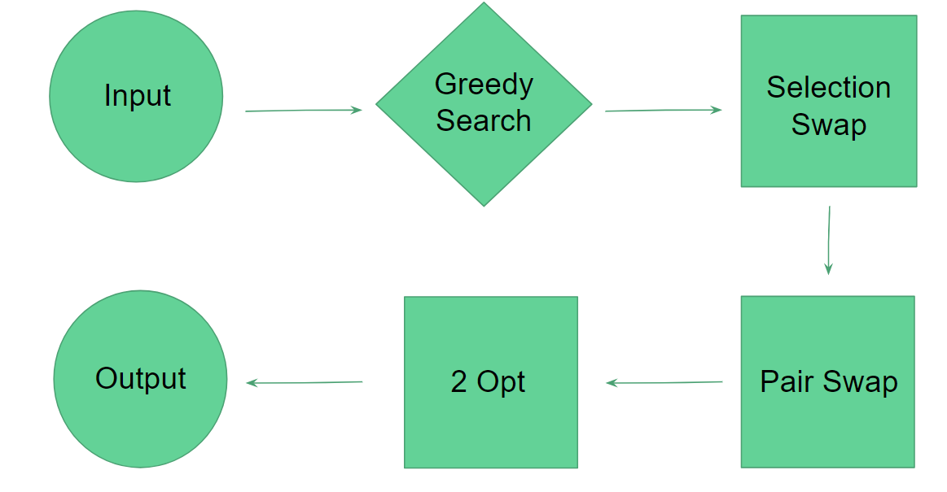
Milestone 4 - Traveling Courier
Start Point
Find a shortest path
Depot 1
Depot 2
Depot 3
.
.
.
.
Depot n
best
Result
Notes:
For milestone 4, firstly we choose to start at any depot (for example depot 1), then we will find a shortest path by using greedy search and 3 kinds of swapping, then we repeat this process for all the other depot and keep the shortest path as the final result.

Slide 5
Example - Start with Depot 1
A (dropoff)
C (pickup)
Depot 1
C (dropoff)
B (dropoff)
A (pickup)
Depot 2
B (pickup)
Notes:
let me use an example to explain how we find the shortest path
suppose depot 1 is the start point

Slide 6
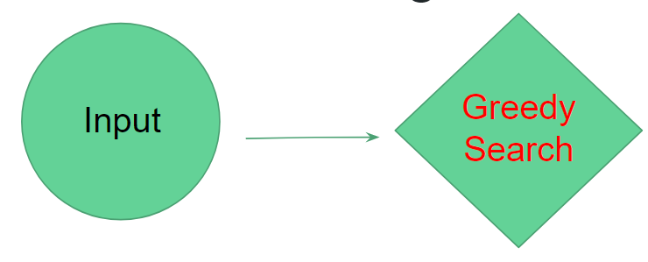
Delivery Order:
1, A↑, C↑, C↓, B↑, B↓, A↓, 2
A (dropoff)
C (pickup)
Depot 1
C (dropoff)
B (dropoff)
A (pickup)
Depot 2
B (pickup)
Notes:
firstly we will compute a path by using greedy search, for each point, we will go to the closest legal point.
start with depot 1, pick up A is the next because it’s the closest point
the next closest point is drop off B, but it is not legal since B is not picked up yet, so we will go to pick up C instead
we will go to drop off C because it’s the closest legal drop off and then pick up B, drop off B, drop off A and end with depot 2
The result we get from greedy search is not always the best solution since it only looks for locally optimal choice, so we come up with 3 ways of changing the delivery order to see if there are better solutions.

Slide 7
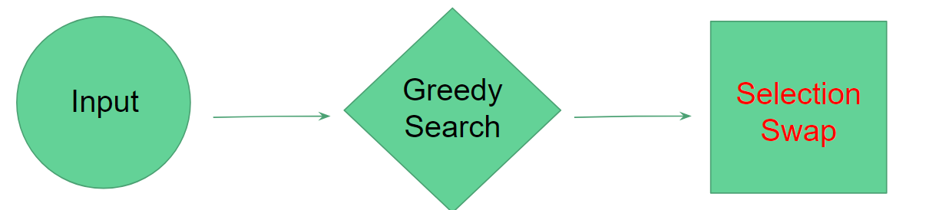
Delivery Order:
1, A↑, C↑, C↓, B↑, B↓, A↓, 2
shift
range
A (dropoff)
C (pickup)
Depot 1
C (dropoff)
B (dropoff)
A (pickup)
Depot 2
B (pickup)
Notes:
the first one is selection swap, we select the point which computes the longest local distance, and change its position in the delivery order
the red line has the longest distance, so we will change the position of drop off A, put it any where after its corresponding pick up so that the path is legal

Slide 8
A (dropoff)
C (pickup)
Depot 1
C (dropoff)
B (dropoff)
A (pickup)
Depot 2
After Selection Swapping
B (pickup)
Original
A (dropoff)
C (pickup)
Depot 1
C (dropoff)
B (dropoff)
A (pickup)
Depot 2
B (pickup)
Notes:
and calculate the total distance of the new path then compare it to the old path
in this case, we will keep the old path because it’s shorter than the new one.

Slide 9
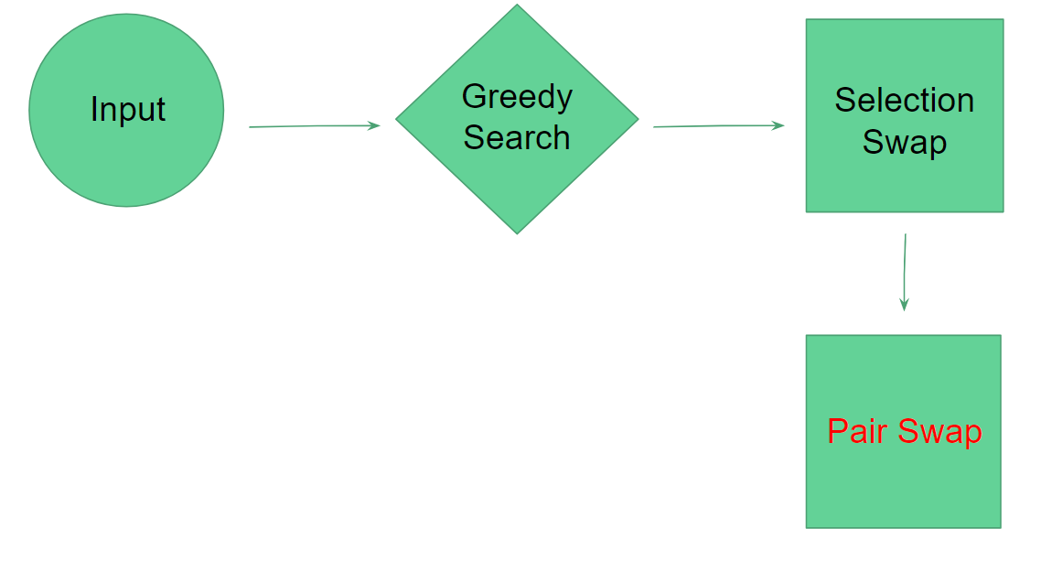
Delivery Order:
1, A↑, C↑, C↓, B↑, B↓, A↓, 2
1, B↑, C↑, C↓, A↑, A↓, B↓, 2
A (dropoff)
C (pickup)
Depot 1
C (dropoff)
B (dropoff)
A (pickup)
Depot 2
B (pickup)
Notes:
the second one is pair swap, we swap the position of two pairs of pick up and drop off, for example, A and B

Slide 10
A (dropoff)
C (pickup)
Depot 1
C (dropoff)
B (dropoff)
A (pickup)
Depot 2
After Pair Swapping
B (pickup)
Original
A (dropoff)
C (pickup)
Depot 1
C (dropoff)
B (dropoff)
A (pickup)
Depot 2
B (pickup)
Notes:
and compare the new path to the old one, we will keep the old path since it’s still shorter than the new one.

Slide 11
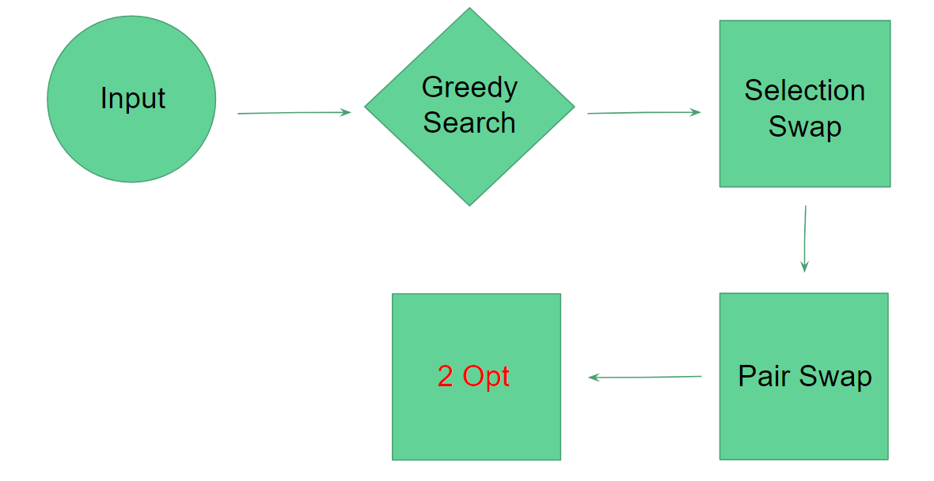
Delivery Order:
1, A↑, C↑, C↓, B↑, B↓, A↓, 2
inverse
1, A↑, B↑, C↓,C↑, B↓, A↓, 2
not legal
A (dropoff)
C (pickup)
Depot 1
C (dropoff)
B (dropoff)
A (pickup)
Depot 2
B (pickup)
Notes:
the last swapping method is 2 opt, we select any two points, and inverse the order between these two points to see if there are better legal results.
if we select pick up A and drop off B, inverse the points between them, since we can’t drop off C before we pick up it, this path is not legal, so we will ignore this one.

Slide 12
Delivery Order:
1, A↑, C↑, C↓, B↑, B↓, A↓, 2
inverse
1, A↑, C↑, B↑, C↓, B↓, A↓, 2
A (dropoff)
C (pickup)
Depot 1
C (dropoff)
B (dropoff)
A (pickup)
Depot 2
B (pickup)
Notes:
if we select pick up C and drop off B, the new path is legal,

Slide 13
A (dropoff)
C (pickup)
Depot 1
C (dropoff)
B (dropoff)
A (pickup)
Depot 2
After 2 Opt Swapping
B (pickup)
Original
A (dropoff)
C (pickup)
Depot 1
C (dropoff)
B (dropoff)
A (pickup)
Depot 2
B (pickup)
Notes:
so we compare it with the old path and find that the old path is still shorter

Slide 14
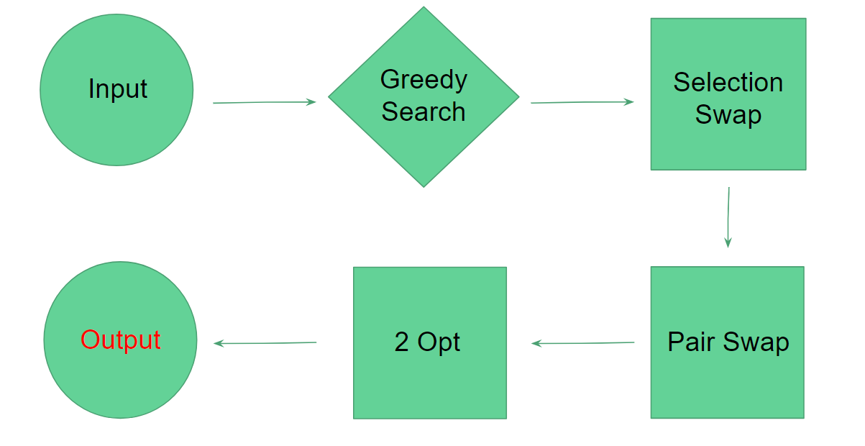
Delivery Order:
1, A↑, C↑, C↓, B↑, B↓, A↓, 2
A (dropoff)
C (pickup)
Depot 1
C (dropoff)
B (dropoff)
A (pickup)
Depot 2
B (pickup)
Notes:
therefore, this is the shortest path if we start with depot 1

